Slide 1
Forward Kinematics and Visualization
Hyun Seok Shin

Slide 2
Table of contents
Overall structure
Forward kinematics
Visualization

Slide 3
Structure of the code
(forward kinematics + visualization)
Inputs:
DH structure
Link length
Mass properties
Joint angles (Optional)
  Code will automatically handle
  if there is no joint angles, joint angles = 0
Forward Kinematics
Visualization
Outputs of forward kinematics (w.r.t global frame in cartesian space):
Joint position
link orientation
CoM of each links
CoM of the whole system

Slide 4
Algorithm of forward kinematics
Parent
Child 1 (has the least amount of grandchild)
Child N (has the greatest amount of grandchild)

Child n

Grandchild 1 (has the least amount of grand grandchild)
Grandchild N (has the least amount of grand grandchild)
Detail in the document


Slide 5
e.g. OP 1 and OP 3
Fictitious Branch
Right Leg
Left Leg
Neck
Right Arm
Left Arm
The body mass is attached to the first link of the right arm.

Slide 6
e.g. Human
Fictitious Branch
Right Leg
Left Leg
Torso
Neck
Right Arm
Left Arm

Slide 7
Output of forward kinematics
Joint positions w.r.t. global frame along time in cartesian space
Link orientation w.r.t. global frame along time
CoM of whole body and each links w.r.t. global frame along time in cartesian space
  { 1 X N_{t} } → { 1 X N_{b} } → { 1 X N_{j} } → [ 1 X 3 ] for position vector or [ 3 X 3 ] for link orientation
  N_{t}: Number of time discretization
  N_{b}: Number of branches
  N_{j}: Number of joints
Use getPos(‘Link Name’), getOrien, getEndPts(‘Link Name’) and getCoM to easily access the forward kinematics data
(Future work)

Slide 8
Structure of visualization
Input Data:
FK result:
Joint position trajectory along time
Joint CoM trajectory along time
System CoM trajectory along time
System Info:
DH Table
Height (for anthropometry ratio)
Make robot structure
Animate
Options (user can choose):
FictitiousOn – turns on and off fictitious branch (default: dash line with fictitious on)
CoMOn – turns on and off CoM markers in animation
is2D – use it for 2D (sagittal plane) model to expand to 3D
Limitation:
System must be a humanoid (symmetric)
a1) to connect right and left legs and arms
a2) to add lateral body
To make it more general, user can manually define how links are connected (need more time to do this)

Slide 9
Algorithm of visualization
Sort Data:
Cell → Array
If 2D, render to 3D
If FictitiousOn, include fictitious branch
A) Determine types of branch:
a1) arm, legs, spines, neck, fictitious
B) Determine parent/child relationship
Building structure:
Define which index in the array to connect with
A) Connect between first index of each arms and legs
B) Connect each joint in a branch
C) Connect according to parent/child relationship
Animation:
For N_{t} recursively draw the system

Slide 10
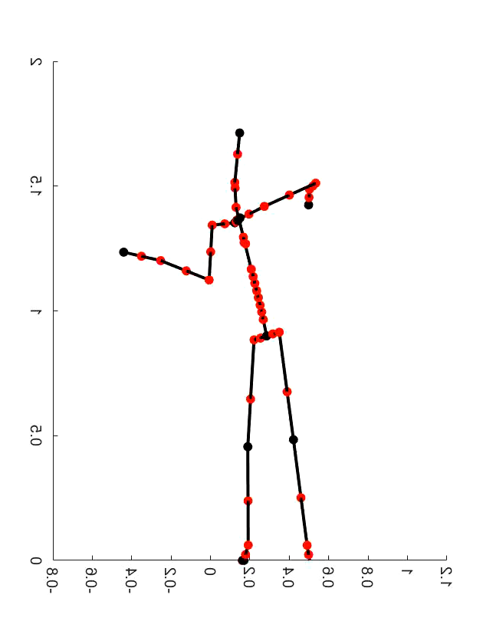
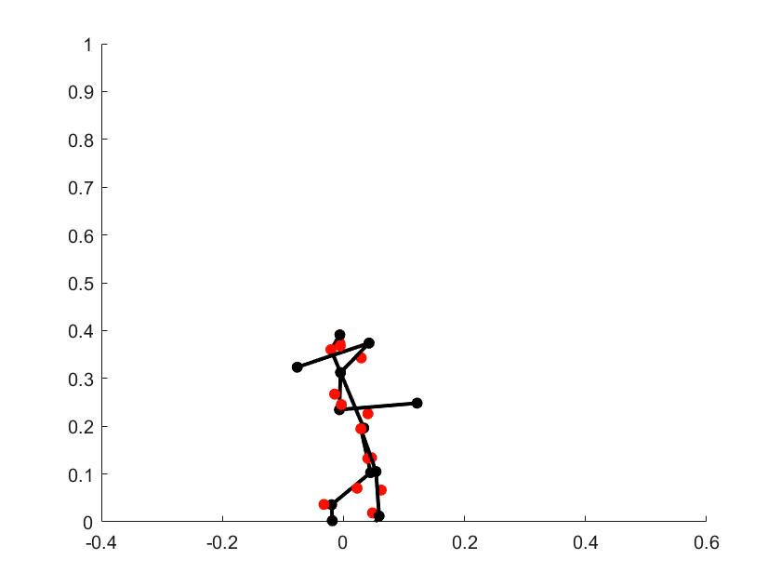
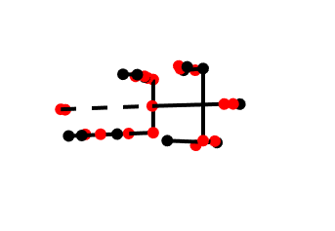
Output of visualization
Darwin Steppable Animation
Human Throwing Animation

Slide 11
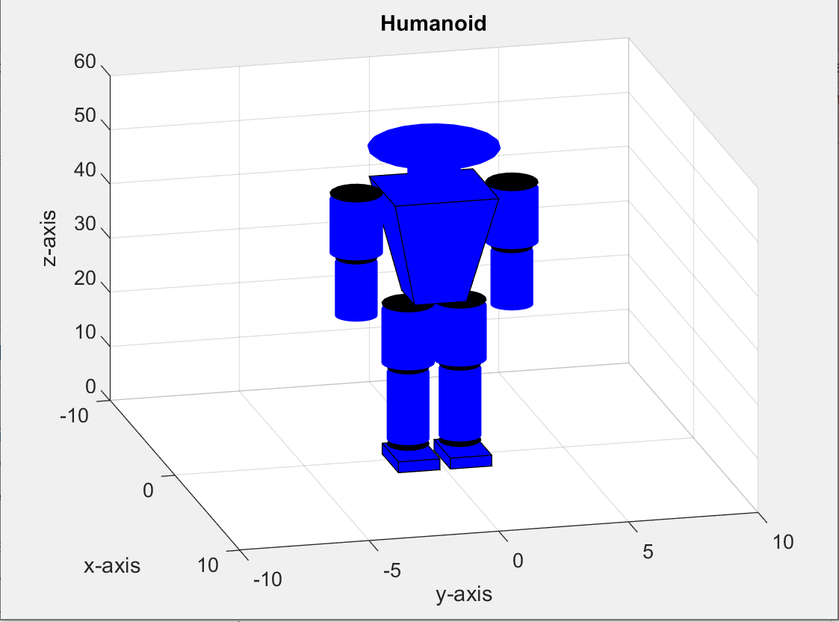
On-going work
Visualization of 3D object
  Jose: working on making function to make 3D objects
  Modify method to sort forward kinematics data
    For example, instead of just outputting only position and structure of a system, need orientation, position, thicknesses of links, and structure of the system
Minor issue: camera angle

Slide 12
Ignore from below

Slide 13
Structure of the code
(forward kinematics +visualization)
Read and sort input data
Forward Kinematics
Visualization
Inputs:
DH structure
Link length
Mass properties
Joint angles (Optional)
  Code will automatically handle
  if there is no joint angles, joint angles = 0
Outputs w.r.t global frame in cartesian space:
Joint position
link orientation
CoM of each links
CoM of the whole system
Outputs:
Animation
Change the structure to make it more clear

Slide 14
Structure of visualization
Read and sort input data
Make robot structure
Animate
Input Data:
FK result:
DH Table
Joint position trajectory along time
Joint CoM trajectory along time
System CoM trajectory along time
System
Height
Options (user can choose):
FictitiousOn – turns on and off fictitious branch (default: dash line with fictitious on)
CoMOn – turns on and off CoM markers in animation
is2D – use it for 2D (sagittal plane) model to expand to 3D
Limitation:
System must be a humanoid (symmetric)
a1) to connect right and left legs and arms
a2) to add lateral body
To make it more general, user can manually define how links are connected (need more time to do this)

